Slide 1
EE 444 Introduction to Computer Networks
Spring 2018

Slide 2
Administrative Details
Instructor: Ece Guran Schmidt
Office: EC-207
Email: eguran@metu.edu.tr
Web page: http://users.metu.edu.tr/eguran/
Schedule: Tuesday: 13:40-15:30@D-131, Thursday: 10:40-11:30@A-208
My main research area is computer networking ☺
You can check out my web page to see what I do in my research

Slide 3
Administrative Details
Follow
https://odtuclass.metu.edu.tr/
for lecture slides and announcements
Your e123456@metu.edu.tr email
Queuing Lecture will be on the white board. Also other notes can be on the white board.
Lectures will be posted on odtuclass
Homework assignments, additional material, study questions are also on odtuclass

Slide 4
Administrative Details
Communication:
Preferred communication mean: E-MAIL
Send with subject including ee444 (no guarantee of reply otherwise)
I will answer your questions any time if you come by my office provided that I am not busy at the moment

Slide 5
Required
Prerequisite(s):
An introductory course on Probability Theory (EE230).
Background Requirement(s):
One of EE441, EE445 or EE447 is strongly recommended.

Slide 6
Advice
This is COMPUTER Networking class. Its primary audience is Computer Option Students.
I do not advise taking this class if you did not take any computer classes last semester.
This is your last term. You cannot replace this class. Any bad result might affect your graduation, GPA, transcript etc.
You have less load this semester I intend to make use of it ☺

Slide 7



Text Books
Copyright notice: Lecture Note Slides are compiled from the teaching material of these books, previous lecture notes of EE444 and additional resources. Part of the slides are entirely created by Ece Schmidt.
Computer Networking: A Top Down Approach , 5th edition / 6th edition. Jim Kurose, Keith Ross Addison-Wesley, 2009/2014
Andrew S. Tanenbaum, David J. Wetherall, Computer Networks,
Ed.5, Prentice-Hall, 2011.

Slide 8
Course Objective (Why should you take this course?)
Basic computer networking technologies
Layered approach/ Modular design/ Interfaces
Concepts of network performance
Performances of some classical networking architectures

Slide 9
Course Outline (Tentative)
Introduction to Computer Networking
Basic Queuing Theory
Application Layer
Transport Layer
Network Layer and Routing
Data Link Layer
Medium Access Control Sublayer
Further subjects (we will decide what to talk about based on the time left at the end of the semester)

Slide 10
(Maybe) Different than other classes
Teaches all major computer components of computer networks in one semester for completeness
No physical layer concepts (channel capacity, sampling, modulation, frequency, interference, noise etc. exist in this course)
Many components and their relations to each other
Both theoretical and practical concepts
COMPREHENSIVE COURSE A LOT OF STUFF

Slide 11
Grading
Mid-term exam: 30% (One midterm!)
Final Exam: 35%
Quizzes: 25%
Practical Work: 10%
Attendance: 5% bonus if you attend 100% of the lectures. Proportionally decreased bonus down to 80% attendance (80% will get 3%).

Slide 12
Grading: Bütünleme
The right to take the final: You need to satisfy both of the following requirements :
Attend at least 2 quizzes OR attend the MIDTERM exam (make-up if you had a valid health excuse on the MIDTERM day). The valid excuse for missing the midterm must be provided before the final.
Submit at least one homework
Your grade will be NA otherwise.
http://oidb.metu.edu.tr/son-yariyilina-kayitli-olan-onlisans-ve-lisans-ogrencileri-icin-butunleme-sinavlari-yonergesi.

Slide 13
Quizzes
Minimum 1 quiz per week in class after add drop. First quiz: February 27th
Content: Class discussions in the previous lecture (s)
Most quizzes will be announced before, some will be pop quiz.
Most quizzes will be at the beginning of the lecture.
Out of X quizzes during the semester, Y highest grades will be included in the final grade.
There is no make up or health excuse for quizzes and attendance.
Bring a piece of paper and pencil with you to all lectures.

Slide 14
Homework assignments/ Practical Work
Possible Written homework assignments, Programming assignments, use of a simulator software, demos.
There will be separate questions in the final exam that evaluate your understanding of these assignments or a separate exam.

Slide 15
A Friendly Reminder
Attend the lectures and do not lose contact with the class!!
Especially towards the end of the semester
Design project, Spring festival, Nice weather…
Idea: Do not focus on any exam. Just come to class and pay attention…and have fun!!!

Slide 16
Introduction to Computer Networking

Slide 17
Why do we need computer networking?
We want to exchange information between/among remote locations (not at the same physical location).
Run applications with different needs

Slide 18

Exchanging information
Internet: Between different geographical locations
Server
Web Browsing (no loss, limited delay)
E-mail (no loss, delay is ok)
Multimedia streaming (Internet radio)
(some loss is ok, limited delay)
IP phone, Skype (some loss is ok, limited delay)
Chat (no loss, limited delay)
P2P file transfer (no loss)

Slide 19
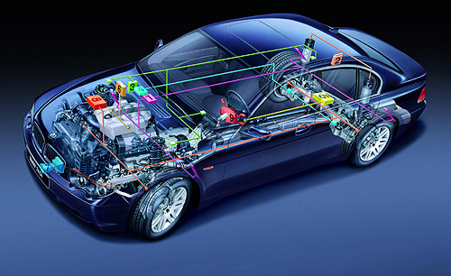
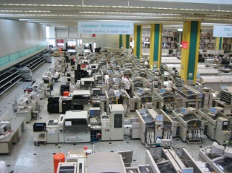
Exchanging information
Embedded environments: Between different system components (micro controllers, sensors)
In vehicle networking
for X-by-wire applications
Example Application: break by wire
Factory floor networking
for manufacturing systems
Real-time, limited delay, no loss

Slide 20
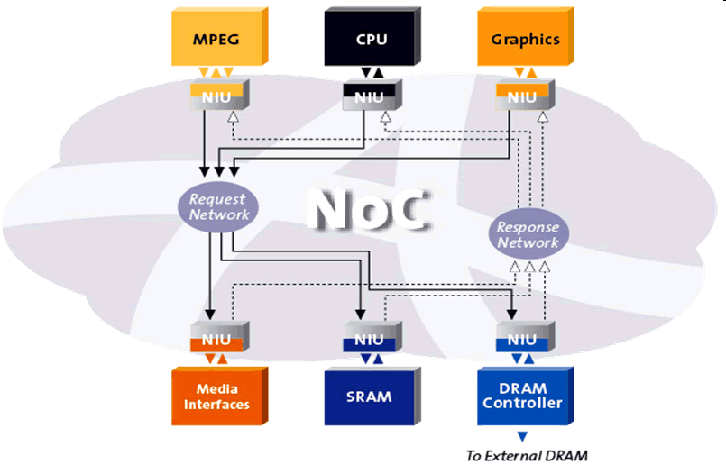
Exchanging information
Network on Chip (NoC): Between different intellectual property blocks on chip
bandwidth

Slide 21
Exchanging information
Different applications with different requirements
Different distances:
Internet, Embedded Systems, Network on Chip
Different physical media:
Copper wire, optical fiber, wireless
Different technologies:
Gigabit Ethernet, 3G/4G/5G Wireless, SONET-SDH
Different speeds
Kbps, Mbps, Gbps

Slide 22
Speed of data transfer
Technology | Speed | Physical Medium | Application
Regular telephone service (POTS) | Up to 56 Kbps | twisted pair | Home and small business access
3G Wireless | 21 Mbps downstream 5.8 Mbps upstream | RF in space (wireless) | Simultaneous access to different services (voice, video etc), Web surfing, instant messaging
4G (LTE Advanced) | Peak download 1Gbps Peak upload 500Mbps | RF in space (wireless) | Simultaneous access to different services (voice, video etc), Web surfing, instant messaging
Fast Ethernet | 100 Mbps | 100BASE-T (twisted pair); 100BASE-T (twisted pair); 100BASE-T (optical fiber) | Most popular business local area network (LAN) Workstations with 10 Mbps Ethernet cards can plug into a Fast Ethernet LAN
Gigabit Ethernet | 1 Gbps | Optical fiber (and "copper" up to 100 meters) | Workstations/networks with 10/100 Mbps Ethernet plug into Gigabit Ethernet switches
OC-48 | 2.488 Gbps | Optical fiber | Backbone
OC-192 | 10 Gbps | Optical fiber | Backbone

Slide 23
Basic Philosophy
Applications do not need to know how the network operates
Server
The computer network should be transparent to the application

Slide 24
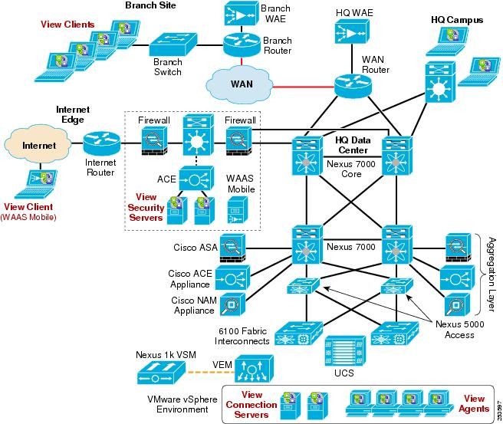
What does a Computer Network look like
A
How does A and B exchange information?
B

Slide 25
Why do we need a network to exchange information? (1)
If you have two computers on two desks in the same room how would you make them communicate?
Just use a cross cable: Point to point communication
How many cables do you need for three computers (all three want to talk to each other)?
How about 1000 computers?
N² problem!

Slide 26
The N ² Problem
For N users to be fully connected directly
Requires N(N – 1)/2 connections
Requires too many cables, too complicated
Inefficient & costly since connections not always on

Slide 27
Networking with switches/routers: Idea
Use special network devices (router/switch)
Connect users on demand
Only N connections
N² problem is moved inside the router/switch
1
N
Router/ switch
N – 1
2
3

Slide 28
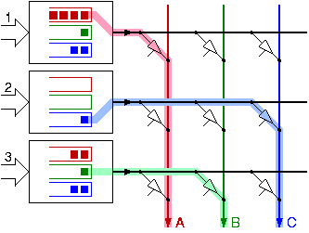
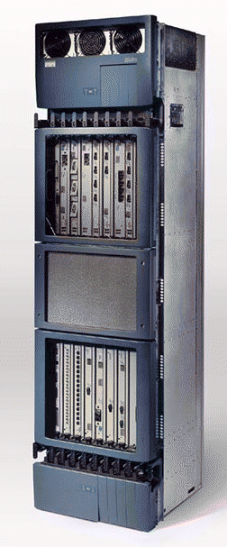
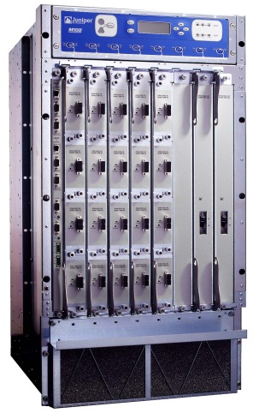
Switching: Switches and routers
On demand N to N I/O connection:
Switch fabric: Special interconnection hardware in the switch/router
Switches packets from inputs to outputs
Inside: Crossbar switch fabric
A
1
Router/ switch
B
2
C
3

Slide 29
Why do we need a network to exchange information? (2)
If you have two computers in two different cities, can you still use a cross cable?
Point to point communication NOT usually practical
Large set of devices would need impractical number of connections
Devices are too far apart
Solution is a computer network

Slide 30

What’s the Internet?
millions of connected computing devices: hosts = end systems
running network apps
PC
Mobile network
server
Global ISP
wireless
laptop
protocols: rules of communication
cellular
handheld
Home network
routers: special network devices
On demand connection
Regional ISP
access
points
communication links
fiber, copper, radio, satellite
transmission rate = bandwidth
Institutional network
wired
links
router
Notes:
30

Slide 31
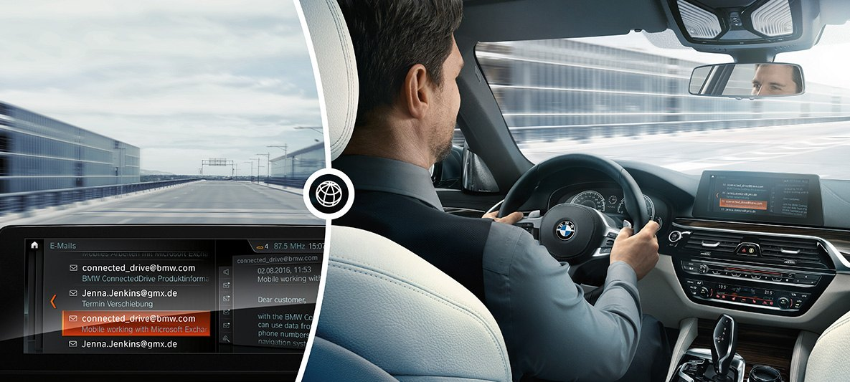
What are the hosts?
Desktop or portable computers, smart phones
Cars
BMW connected drive
https://www.cnet.com/roadshow/news/bmw-basically-wants-you-to-live-work-inside-your-connected-car/

Slide 32
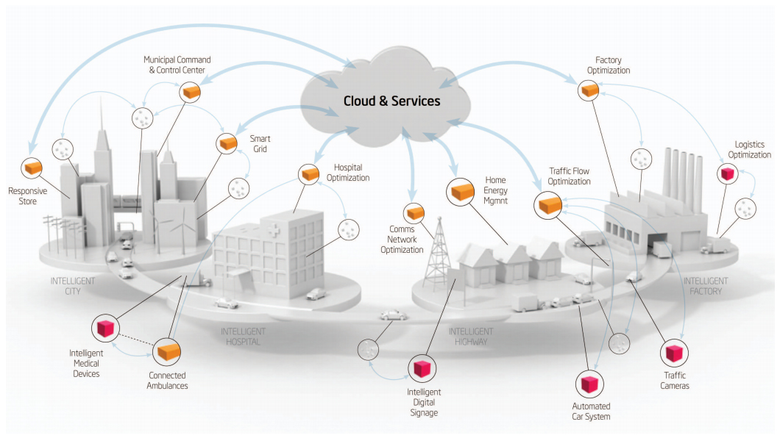
What are the hosts?
Any thing!
“Internet of things”

Slide 33
What’s the Internet: Protocols
Communications between computers require very specific unambiguous rules
protocols define format, order of msgs sent and received among network entities, and actions taken on msg transmission, receipt
e.g., TCP, IP, HTTP, Skype, Ethernet
Mobile network
Global ISP
Home network
Regional ISP
Institutional network
Notes:
33

Slide 34


A human protocol and a computer network protocol
Hi
TCP connection
request
Hi
TCP connection
response
Got the
time?
Get http://www.awl.com/kurose-ross
2:00
<file>
time
Notes:
34

Slide 35
A closer look at network structure
network edge:
Low-speed
applications and hosts
network core:
High-speed
interconnected routers
network of networks
access networks, physical media:
Connection between edge and core
Edge routers
wired, wireless communication links
Notes:
35

Slide 36
Access Networks: Digital Subscriber Line (DSL)
Existing phone line: 0-4KHz phone; 4-50KHz upstream data; 50KHz-4MHz downstream data
Internet
home
phone
DSLAM
telephone
network
splitter
DSL
modem
central
office
home PC
uses existing telephone infrastructure
modulates frequencies from 4000 Hz to as high as 4 MHz.
up to 3.3 Mbps upstream and up to 24 Mbps downstream
dedicated physical line to telephone central office

Slide 37
Access Networks: Ethernet
100 Mbps
institutional
router
Ethernet
switch
to institution’s ISP
100 Mbps
1 Gbps
100 Mbps
server
typically used in companies, universities, etc
10 Mbs, 100Mbps, 1Gbps, 10Gbps Ethernet
today, end systems typically connect into Ethernet switch

Slide 38
Wireless access networks
shared wireless access network connects end system to router
via base station aka “access point”
wireless LANs:
802.11b/g (WiFi): 11 or 54 Mbps
cellular wireless access
provided by telco operator
3G/4G (LTE)/5G
router
base
station
mobile
hosts
Notes:
38

Slide 39
The Network Core
mesh of interconnected routers
the fundamental question: how is data transferred through net?
circuit switching: dedicated circuit per call: telephone net
packet-switching: data sent thru net in discrete “chunks”
Notes:
39

Slide 40
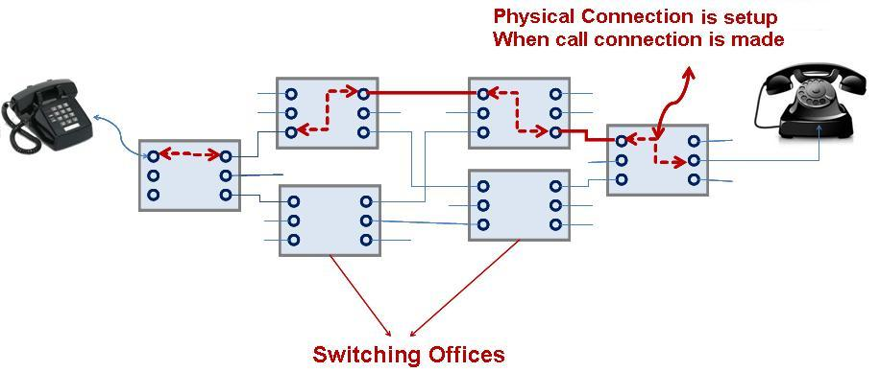
Network Core: Circuit Switching
Similar to phone call:
1) Dial: Connection set up
2) Ring: Signaling
3) Talk: Data Transfer
4) Hang up: Connection tear down
Notes:
40

Slide 41
Network Core: Circuit Switching
end-end resources reserved for “call”
link bandwidth, switch capacity
dedicated resources: no sharing
circuit-like (guaranteed) performance
Signaling and call setup before data transfer are required
Notes:
41

Slide 42
Network Core: Circuit Switching
network resources (e.g., bandwidth) divided into “pieces”
pieces allocated to calls
resource piece idle if not used by owning call (no sharing)
dividing link bandwidth into “pieces”
frequency division
time division
Notes:
42

Slide 43
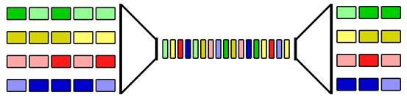
Circuit Switching: TDM
Low bit rate input
lines from different sources
Low bit rate output
lines to different users
MUX
DEMUX
High bit rate multiplexed data stream
Single high speed channel
Fixed duration time slots allocated to each connection
Muliplexer gives exactly the same amount of time to each device connected to it.
This time slice is allocated even if a device has nothing to transmit.
Notes:
43
Two simple multiple access control techniques.
Each mobile’s share of the bandwidth is divided into portions for the uplink and the downlink. Also, possibly, out of band signaling.
As we will see, used in AMPS, GSM, IS-54/136

Slide 44
Circuit switching
What is good?
The quality! No delay, reliable service
How is it used?
Digital Phone
Example: Is Bankasi can buy a “1 Mbit/s circuit” between its Istanbul and Ankara headquarters from Turk Telekom
Two buildings always stay physically connected
What is bad?
Expensive, inefficient (stays on even if not used)

Slide 45
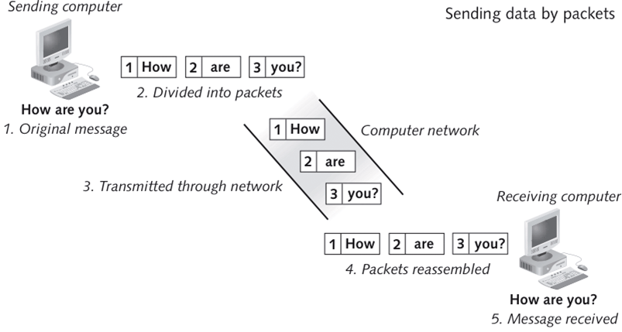
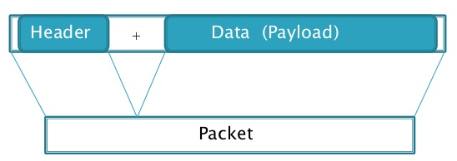
Network Core: Packet Switching
each end-end data stream divided into packets
Header: control information

Slide 46
Network Core: Packet Switching
each packet uses full link bandwidth
user A, B share network resources
resources used as needed
store and forward: packets move one hop at a time
node receives complete packet before forwarding
A
Router output port L
R
B
statistical
multiplexing
queue of packets
waiting for output
link
Notes:
46

Slide 47
Network Core: Packet Switching
A and B are connected to the router R on two different input ports.
A and B send packets at the same time
Both packets’ destination: output port L
One packet is transmitted the other one is stored in the queue
resource contention:
aggregate resource demand can exceed the available amount
congestion: packets queue, wait for link use
A
Router output port L
R
B
statistical
multiplexing
queue of packets
waiting for output
link
Notes:
47

Slide 48
Packet Switching: Statistical Multiplexing
100 Mb/s
Ethernet
A
C
statistical multiplexing
1.5 Mb/s
B
queue of packets
waiting for output
link
D
E
sequence of A & B packets has no fixed timing pattern
bandwidth shared on demand: statistical multiplexing.
Notes:
48

Slide 49
Packet switching versus circuit switching
Example:
1 Mb/s link
each user:
100 kb/s when “active”
active 10% of time
circuit-switching:
10 users
packet switching:
with 35 users, probability > 10 active at same time is less than .0004
…..
N
users
1 Mbps link
Q: how did we get value 0.0004?
Q: what happens if > 35 users ?
Packet switching allows more users to use the network!
Notes:
49

Slide 50
Packet switching
What is good?
Efficiency: Multiple user pairs can use the same link at the same time (one packet at a time)
How is it used?
Internet: Packets from all applications use the same links all the time
What is bad?
Quality, no dedicated service
My email packet can go before your voice (skype) packet

Slide 51
Network Performance Criteria
Bounded delay
Small delay variation (jitter)
Small packet-loss probability
Maximum Throughput~100%
Service differentiation among classes of traffic
Example: For high class traffic packet loss ratio<10⁻¹⁰

Slide 52
WE MOVE TO SEVIM TAN NEXT WEEK
D231

Slide 53
How do loss and delay occur?
packets queue in router buffers
packet arrival rate to link temporarily exceeds output link capacity
packets queue, wait for turn
packet being transmitted (delay)
A
B
packets queueing (delay)
free (available) buffers: arriving packets
dropped (loss) if no free buffers
Notes:
53

Slide 54
Four sources of packet delay
transmission
A
propagation
B
nodal
processing
queueing
d_{nodal} = d_{proc} + d_{queue} + d_{trans} + d_{prop}
d_{proc}: nodal processing
check bit errors
determine output link
typically < msec
d_{queue}: queueing delay
time waiting at output link for transmission
depends on congestion level of router
Notes:
54

Slide 55
Four sources of packet delay
transmission
A
propagation
B
nodal
processing
queueing
d_{nodal} = d_{proc} + d_{queue} + d_{trans} + d_{prop}
d_{trans}: transmission delay:
L: packet length (bits)
R: link bandwidth (bps)
d_{trans} = L/R
d_{prop}: propagation delay:
d: length of physical link
s: propagation speed in medium (~2x10⁸ m/sec)
d_{prop} = d/s
d_{trans} and d_{prop}
very different
Notes:
55

Slide 56
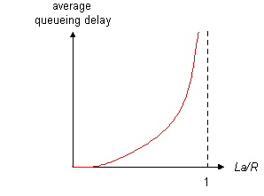
Queueing delay
R: link bandwidth (bps)
L: packet length (bits)
a: average packet arrival rate
average queueing delay
traffic intensity
= La/R
La/R ~ 0: avg. queueing delay small
La/R -> 1: avg. queueing delay large
La/R > 1: more “work” arriving
than can be serviced, average delay infinite!
Notes:
56

Slide 57
“Real” Internet delays and routes
What do “real” Internet delay & loss look like?
Traceroute program: provides delay measurement from source to router along end-end Internet path towards destination. For all i:
sends three packets that will reach router i on path towards destination
router i will return packets to sender
sender measures time interval between transmission and reply.
3 probes
3 probes
3 probes
Notes:
57

Slide 58
“Real” Internet delays and routes
tracert www.ece.cmu.edu
Three ROUNDTRIP delay measurements
Tracing route to www.ece.cmu.edu [128.2.131.66]over a maximum of 30 hops:
1 4 ms 9 ms 4 ms eeatm.eee.metu.edu.tr [144.122.166.1]
2 1 ms 1 ms 1 ms rt1.metu.edu.tr [144.122.2.1]
3 40 ms 44 ms 29 ms 144.122.1.21
4 12 ms 3 ms 3 ms 193.140.85.137
5 10 ms 12 ms 11 ms 193.140.0.150
6 31 ms 32 ms 32 ms ulakbim.mx1.bud.hu.geant.net [62.40.125.129]
7 46 ms 46 ms 46 ms 62.40.98.47
8 136 ms 136 ms 140 ms internet2-gw.mx1.fra.de.geant.net [62.40.125.18]
9 142 ms 142 ms 142 ms internet2-re-wash.3rox.net [192.88.115.82]
10 146 ms 146 ms 146 ms pod-i-nh.cmu.3rox.net [147.73.16.121]
11 147 ms 148 ms 147 ms CORE0-POD-I-DCNS.GW.CMU.NET [128.2.0.193]
12 143 ms 143 ms 143 ms POD-A-CORE0.GW.CMU.NET [128.2.0.154]
13 144 ms 145 ms 144 ms ECE-RTR-POD-A-CYH.GW.CMU.NET [128.2.35.210]
14 146 ms 146 ms 147 ms WWW.ECE.CMU.EDU [128.2.131.66]
Trace complete.
Notes:
58

Slide 59
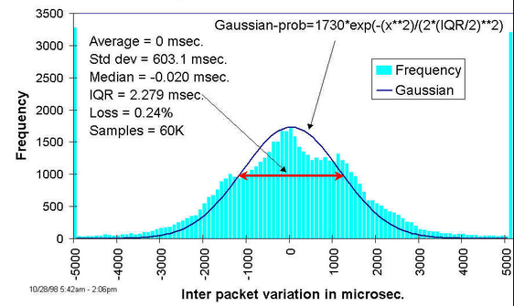
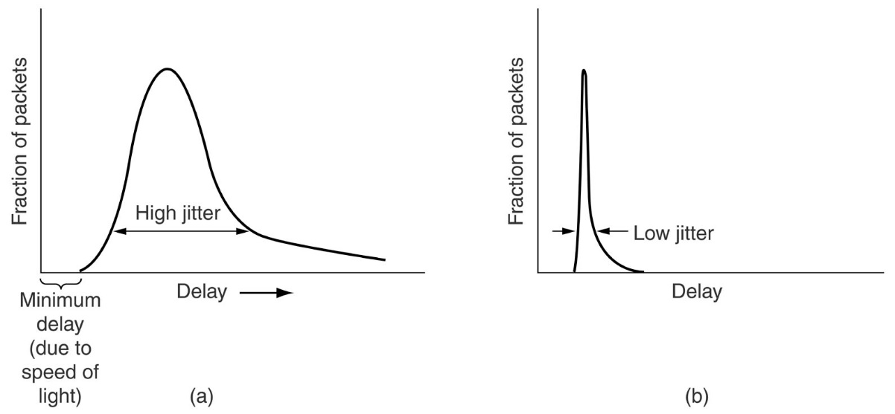
Delay Variation
Packets have variable delay because of changing network conditions
Jitter: Delay variation

Slide 60
Packet loss
queue (aka buffer) preceding link in the router has finite capacity
packet arriving to full queue dropped (aka lost)
lost packet may be retransmitted by previous node, by source end system, or not at all
buffer
(waiting area)
packet being transmitted
A
B
packet arriving to
full buffer is lost
Notes:
60

Slide 61
Throughput
throughput: rate (bits/time unit) at which bits transferred between sender/receiver
instantaneous: rate at given point in time
average: rate over longer period of time
server, with
file of F bits
to send to client
link capacity
R_{s} bits/sec
BOTTLENECK
link capacity
R_{c} bits/sec

Slide 62
Network Organization
Networks are complex,
with many “pieces”:
hosts
routers
links of various media
applications
protocols
hardware, software
Question:
Is there any hope of organizing structure of network?
Notes:
62

Slide 63
Solution: Layered Protocol Architecture
Task broken into subtasks
Layers (similar to software/hardware modules):
each layer implements a service via its own internal-layer actions
relying on services provided by layer below
Each layer in a component communicates with the layer above and below (vertical)
Peer layers in all components communicate (horizontal)

Slide 64


Example Problem
Philosopher 1
Lives in Location A
Speaks English
Philosopher 2
Lives in Location B
Speaks French
Philosopher 1 has a message for Philosopher 2: I like rabbits
Goal: They should communicate as if they are directly talking to each other as peers

Slide 65
Layered Protocol Architecture
The philosopher-translator-secretary architecture.
The philosopher
needs the
service
of the translator
The philosopher
needs the
service
of the translator
The translator
needs the
service
of the secretary
The translator
needs the
service
of the secretary
The secretary
needs the
service
of the fax
The secretary
needs the
service
of the fax

Slide 66
Layered Protocol Architecture
Philosophers
are peers
Translators
are peers
Secretaries
are peers
Actual data transmission via fax

Slide 67
What is a network layer
A module that has software and hardware components
Responsible for a certain task
communicates with its peer on the other side to fulfill its task
Requires that some other tasks are correctly carried out to fulfill its own purpose➔ Uses the services of lower layers
Provides service to upper layers such that they can fulfill their tasks
Notes:
67

Slide 68
Why layering?
Dealing with complex systems:
explicit structure allows identification, relationship of complex system’s pieces
layered reference model for discussion
Modularization eases maintenance, updating of system
change of implementation of layer’s service transparent to rest of system
e.g., change in a procedure doesn’t affect rest of system
Any disadvantage?
Notes:
68

Slide 69
Internet protocol stack
application: supporting network applications
FTP, SMTP, HTTP
transport: process-process data transfer
TCP, UDP
network: routing of datagrams from source to destination
IP, routing protocols
link: data transfer between neighboring network elements
Ethernet, 802.111 (WiFi), PPP
physical: bits “on the wire”
application
transport
network
link
physical
Notes:
69

Slide 70
ISO/OSI reference model
presentation: allow applications to interpret meaning of data, e.g., encryption, compression, machine-specific conventions
session: synchronization, checkpointing, recovery of data exchange
application
presentation
session
transport
network
link
physical
Introduction 1-70
Notes:
70

Slide 71
OSI vs Internet Protocol Stack
application
presentation
session
transport
network
link
physical
application
transport
internet
link
physical
OSI: Theoretical
Internet Protocol Stack: Practical

Slide 72
Layered Architecture: Application Layer
host or
server
host or
server
application
controlled by
app developer
application
process
process
Ankara
Pittsburgh
Application Layer:
Ece wants to browse a web page located in a server in the US
It should look as if 2 processes communicate on the same machine
Network should be invisible: Network cloud

Slide 73
Layered Architecture: Application Layer
host or
server
host or
server
application
controlled by
app developer
application
process
process
application
Ankara
Pittsburgh
Application Layer:
Defines message formats between the processes
Determines the order and timing of the messages

Slide 74
Layered Architecture: Application Layer
host or
server
host or
server
application
transport
controlled by
app developer
application
transport
process
process
Ankara
Internet
Pittsburgh
Application Layer needs:
Correct and in order delivery of the messages
Solution:
Application layer uses the services of the Transport Layer

Slide 75
Layered Architecture: Transport Layer
host or
server
host or
server
application
transport
controlled by
app developer
application
transport
process
process
Ankara
Internet
Pittsburgh
Transport Layer :
provides logical communication between app processes running on different hosts
run in end systems (hosts)
send side: breaks app messages into segments, sends to the other host
rcv side: reassembles segments into messages, passes to app layer

Slide 76
Layered Architecture: Transport Layer
host or
server
host or
server
application
transport
network
controlled by
app developer
application
transport
network
process
process
Ankara
Internet
Pittsburgh
Transport Layer needs :
Actual delivery of the messages to the other machine over the network cloud
If the messages are delivered “somehow” the transport layer can provide the service of orderly delivery to the application layer
Solution:
Transport Layer uses the services of the Network Layer

Slide 77
Layered Architecture: Network Layer
Provides the service of sending the segment from sending to receiving host
Network layer protocols in every host, router
Router examines header fields in all packets passing through it
application
transport
network
network
network
network
network
network
network
network
network
l
application
transport
network

Slide 78
Layered Architecture: Network Layer
Network Layer needs:
To send the packet reliably from one node to other node
Such that it gets to the destination node
Solution:
Network Layer uses the services of the Data Link Layer
application
transport
network
data link
network
data link
network
data link
network
data link
network
data link
network
data link
network
data link
network
data link
l
network
data link
application
transport
network
data link

Slide 79
Layered Architecture: Data Link Layer
hosts and routers are nodes
communication channels that connect adjacent nodes along communication path are links
wired links
wireless links
LANs
Data-link layer:
has responsibility of
transferring datagram from one node
to adjacent node over a link

Slide 80
Layered Architecture: Data Link Layer
Data Link Layer needs:
To actually send the information to the next node
Solution:
Data Link Layer uses the services of the Physical Layer
application
transport
network
data link
physical
network
data link
physical
network
data link
physical
network
data link
physical
network
data link
physical
network
data link
physical
network
data link
physical
network
data link
physical
network
data link
physical
application
transport
network
data link
physical

Slide 81
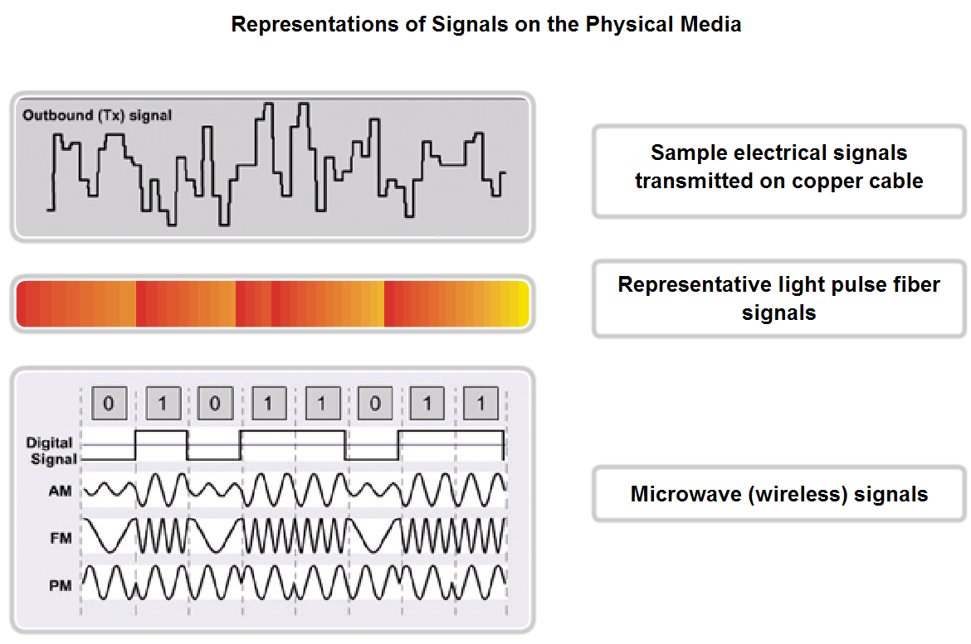
Layered Architecture: Physical Layer
Representing information in signals
How much can be represented
How to represent, how to interpret
Transmission media
Provides the means to transmit bits from sender to receiver
Data must be transformed to electromagnetic signals to be transmitted.

Slide 82
Encapsulation
source
message
M
application
transport
network
link
physical
segment
H_{t}
M
H_{t}
datagram
H_{n}
H_{n}
H_{t}
M
frame
H_{l}
H_{n}
H_{t}
M
link
physical
switch
destination
H_{n}
H_{t}
M
network
link
physical
M
application
transport
network
link
physical
H_{l}
H_{n}
H_{t}
M
H_{n}
H_{t}
M
H_{t}
M
H_{n}
H_{t}
M
H_{l}
H_{n}
H_{t}
M
router
Notes:
82

Slide 83
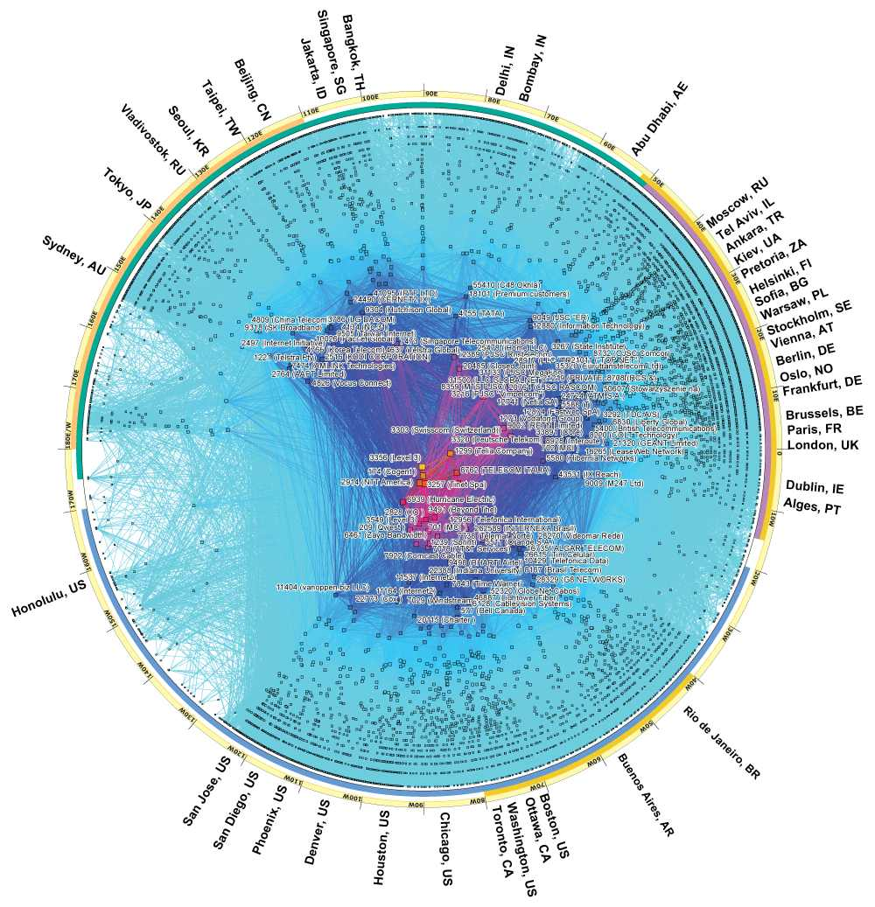
Current Internet
https://www.caida.org/research/topology/as_core_network/2017/

Slide 84
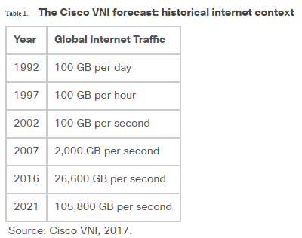
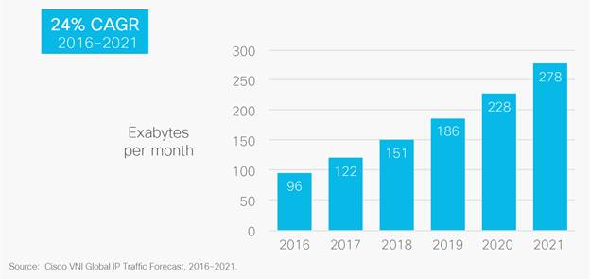
Current Internet
https://www.cisco.com/c/en/us/solutions/collateral/service-provider/visual-networking-index-vni/vni-hyperconnectivity-wp.html

Slide 85
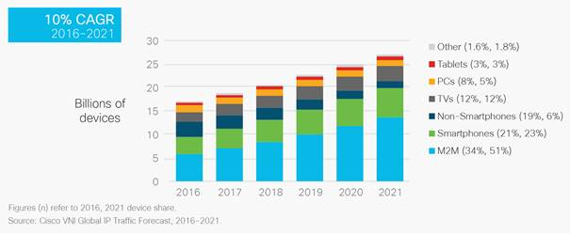
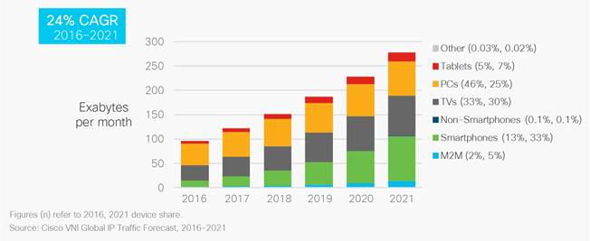
Hosts

Slide 86
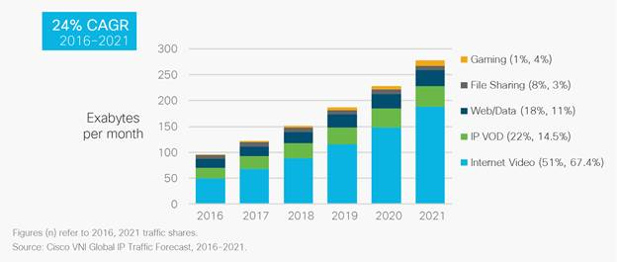
Applications

Slide 87
MIDTERM: 11th of APRIL WEDNESDAY 840
FIRST QUIZ 27th of FEBRUARY 1340 in Class
DON’T BE LATE

Slide 88
Introduction to Computer Networking

